Slide 1
Heart DISEASE
CONTINUE
Zafrul Azim Nazir (U2222454J)
Yves Samson Li (U2222560G)
A126 Team 8
Health and lifestyle factors in predicting Heart Disease

Slide 2
TABLE OF CONTENTS
1
2
3
4
5
PREV
NEXT
Practical Motivation
Data Cleaning
Exploratory Data analysis
Machine learning
Insights

Slide 3
1
Practical motivation
PREV
NEXT
You can enter a subtitle here in case you need it

Slide 4
32%
Of total deaths reported globally in 2021 due to heart diseases(SHF,2022)

Slide 5
PREVALENCE
PREV
NEXT
1
USA
1
697,000 deaths yearly - 1 in 5 deaths
2
Singapore
2
24292 deaths in 2021

Slide 6
What are some health factors and lifestyle habits that increases risk of heart disease?
PREV
NEXT
Notes:
Many deaths are caused by it worldwide and hence we wanted to find out what caused heart disease.

Slide 7
Data cleaning
2
PREV
NEXT

Slide 8
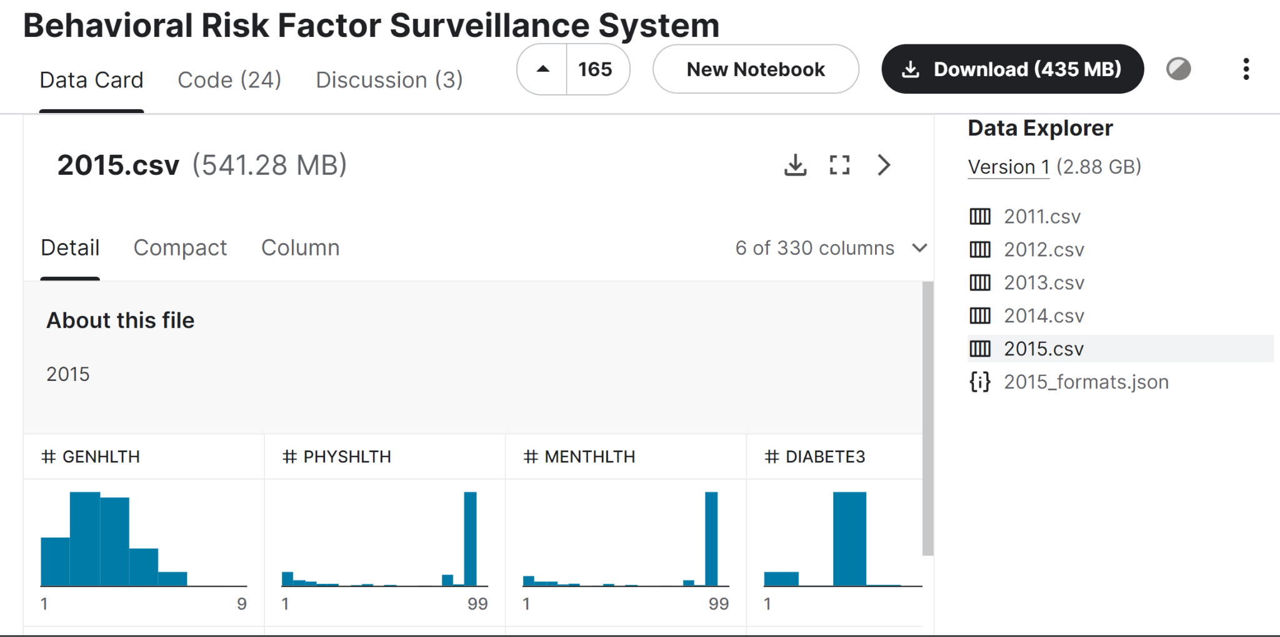
PREV
NEXT
Dataset
Notes:
Talk about how it is a survey so they are possibilities of estimates given by respondents

Slide 9
Data cleaning
Filtering of relevant variables
Dropping data with excessive missing data
As dataset is from a survey
Dropping data set with “unsure” as an answer
Renaming categorical variables categories

Slide 10
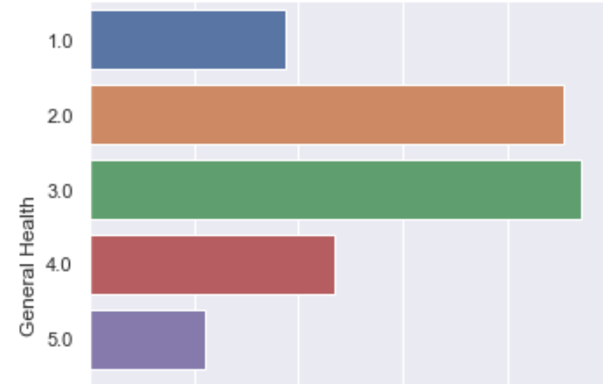
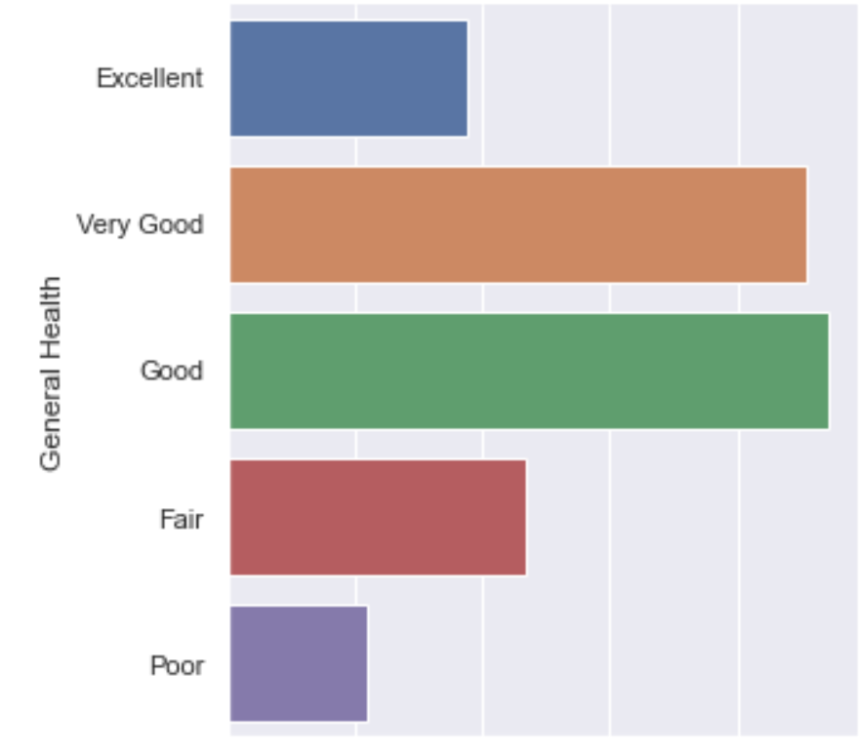
Renaming categorical variables categories

Slide 11
Initial Variables list
Integer Categorical
Physical health
Age
Alcohol Consumption
Mental health
General Health
Exercise rate
High Cholesterol
High Blood Pressure
Gender
Smoking Rate
Kidney Disease
Asthma
Skin cancer
Heart Attack
Stroke
Checkup
Difficulty walking
Race
Heart Disease(response)

Slide 12
Exploratory Data analysis
3
PREV
NEXT

Slide 13
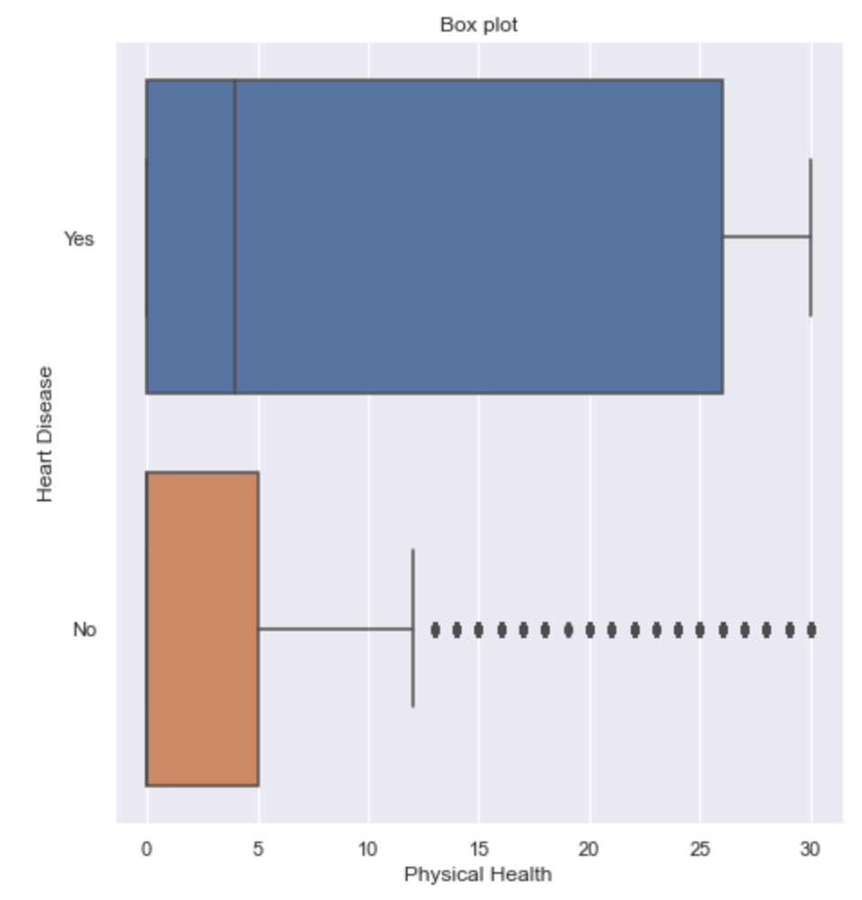
Boxplot shows the distribution of the data.
From the plot, we can see that generally higher physical health score(higher being worse) correlates to having heart disease
Notes:
We will go thru some of them as we have many variables

Slide 14
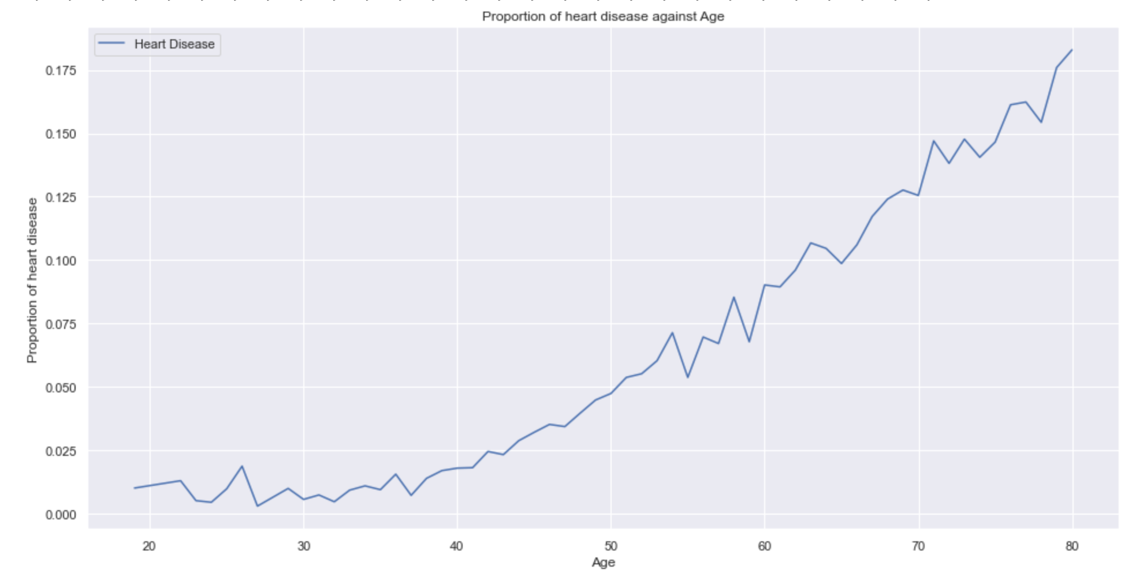
PREV
NEXT
A
G
E
General linear relationship between age and proportion of individuals with heart disease

Slide 15
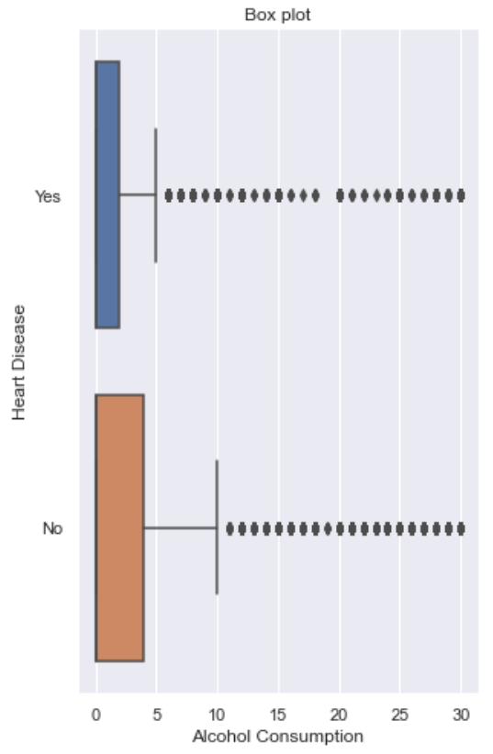
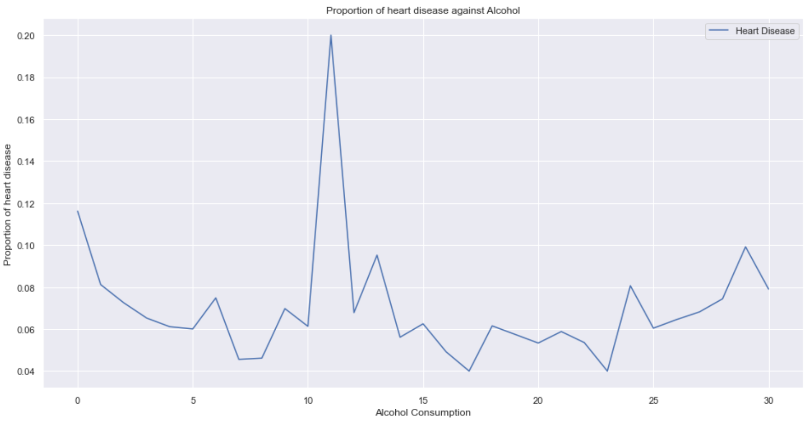
Alcohol consumption
Due to excessive number of outliers, and the relatively flat line graph with fluctuations, we decided to drop this variable
*Same for mental health
Notes:
We will go thru some of them as we have many variables

Slide 16
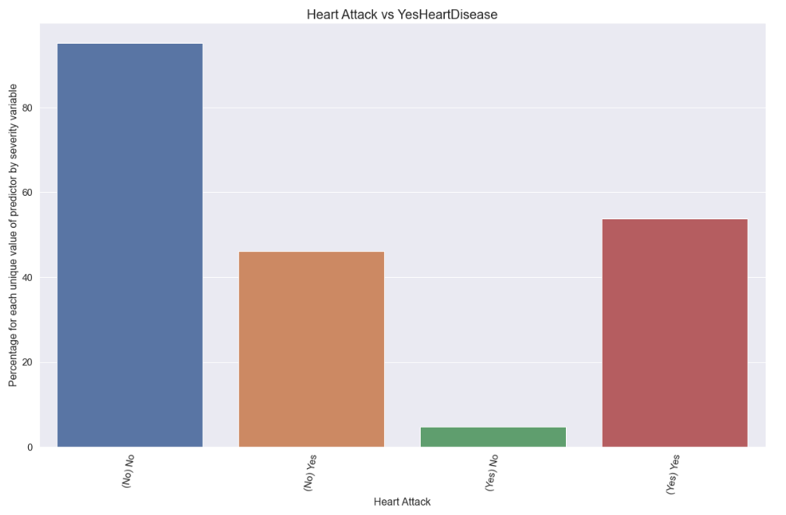
PREV
NEXT
This graphs shows the percentage of individuals compared to whether they had a heart attack before

Slide 17
Machine learning
4
PREV
NEXT

Slide 18
Steps taken in machine learning
1
2
3
4
PREV
NEXT
Chi-square
Skewness
Data imbalance
Cross-entropy
Chi-square test of independence
Reduction of skewness
Machine learning model
No sampling, undersampling and oversampling

Slide 19
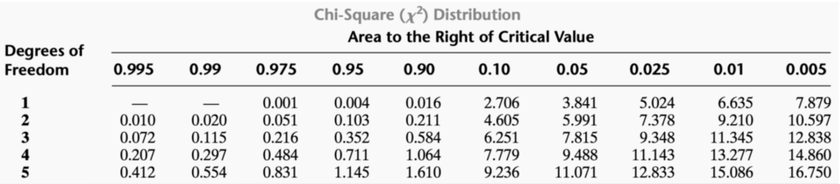
Chi Square test of independence
Chi Square value > critical value - there is a relationship
Higher Cramer’s V - Stronger the strength of relationship
Notes:
Talk about what chi square is and what is finds

Slide 20
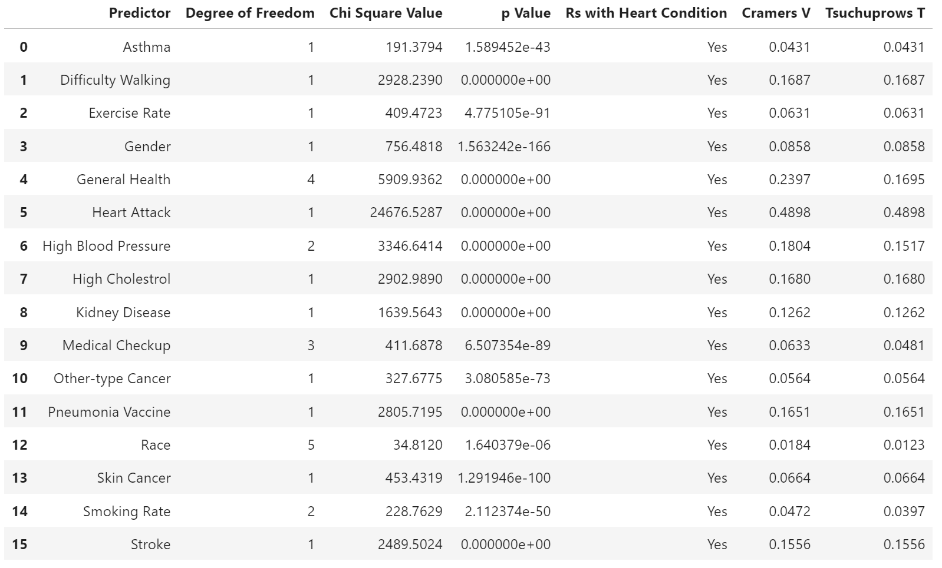
PREV
NEXT
Chi square results using 5% significance value
Notes:
A significance level of 0.05 indicates a 5% risk of concluding that an association between the variables exists when there is no actual association which is a good benchmark

Slide 21
Selected variables
PREV
NEXT
Variables | Relationship with Heart disease | Cramer’s V(2dp)
Heart attack | Yes | 0.49
General health | Yes | 0.24
High blood pressure | Yes | 0.18
Difficulty walking | Yes | 0.17
Pneumonia vaccine | Yes | 0.17
High cholesterol | Yes | 0.17
Stroke | Yes | 0.16

Slide 22
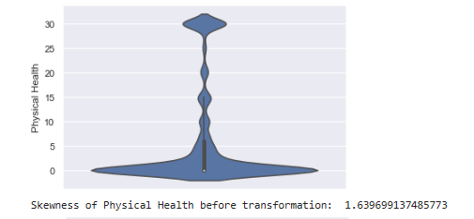
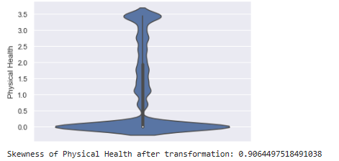
Handling Skewness
PREV
NEXT
Logarithmic Transformation
Before
Logarithmic Transformation
After
Logarithmic Transformation
Notes:
Taking the undersampled calibration curve, which is used to compare how well the probabilistic predictions of a binary classifier are calibrated. The more points on the line, the more accurate. We applied Isotonic regression which is an algorithm that finds a non-decreasing approximation of a function which are the closests to the target while minimizing the mean squared error on the training data. And we can see it is more concise now
https://scikit-learn.org/stable/modules/calibration.html#:~:text=Calibration%20curves%20(also%20known%20as,predicted%20probability%20in%20each%20bin.

Slide 23
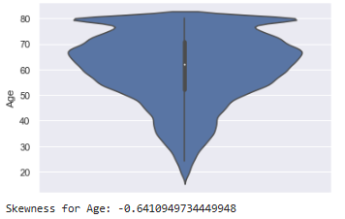
PREV
NEXT
Handling Skewness

Slide 24
Taking data imbalance into account
PREV
NEXT
Original
Under- sampling
Over-sampling
We will run our machine learning model 3 times, once with original, once with undersampling and once with oversampling
Notes:
As stated earlier, we notice that there was an imbalance of data from our sample test data. By taking that into account, we will under-sample and over-sample our training data and re-trained to see how it impacts the model that we used for our model optimization.

Slide 25
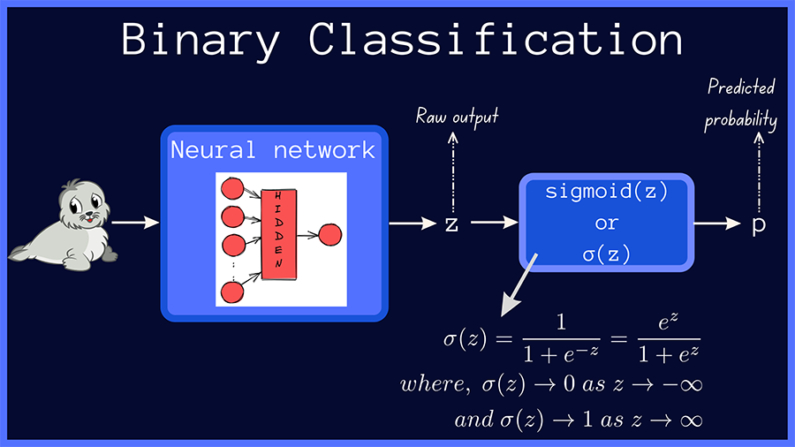
Machine Learning Models
PREV
NEXT
Binary Classification Model
A supervised learning model in machine learning that involves predicting one of two possible outcomes
Notes:
https://www.learndatasci.com/glossary/binary-classification/#:~:text=each%20binary%20classifier-,What%20is%20Binary%20Classification%3F,Application

Slide 26
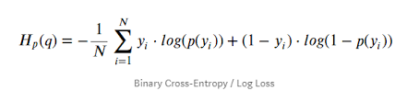
Machine Learning Models
PREV
NEXT
Binary Cross-Entropy Loss
A loss function, that tracks incorrect labeling of the data class by a model.
Notes:
https://arize.com/blog-course/binary-cross-entropy-log-loss/#:~:text=What%20Is%20Binary%20Cross%20Entropy,equate%20to%20high%20accuracy%20values.

Slide 27
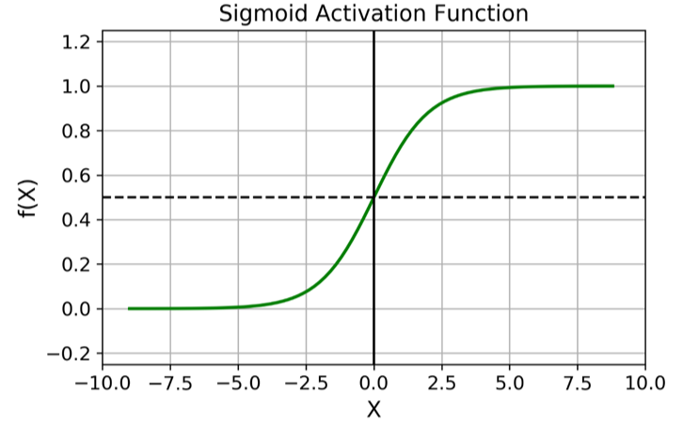
Machine Learning Models
PREV
NEXT
Sigmoid Activation
A nonlinear function, commonly applied at the output of the neuron’s that produces an output between 1 and 0.
Notes:
https://www.analyticsvidhya.com/blog/2023/01/why-is-sigmoid-function-important-in-artificial-neural-networks/#:~:text=Source%3A%20Pexels-,The%20sigmoid%20function%20is%20commonly%20used%20as%20an%20activation%20function,non%2Dlinearity%20into%20the%20model.

Slide 28
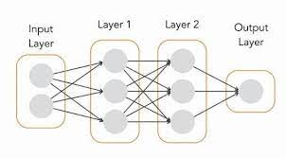
Machine Learning Models
PREV
NEXT
Sequential model
Neural network model, in which the layers are stacked in a chain-like structure.
Notes:
https://towardsdatascience.com/a-comprehensive-introduction-to-tensorflows-sequential-api-and-model-for-deep-learning-c5e31aee49fa#:~:text=The%20sequential%20model%20allows%20us,for%20building%20deep%20learning%20models.

Slide 29
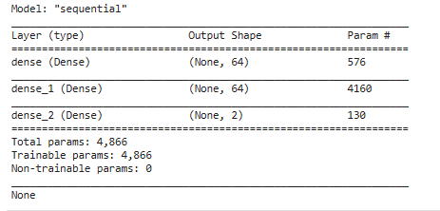
Original Data - Machine Learning
PREV
NEXT

Slide 30
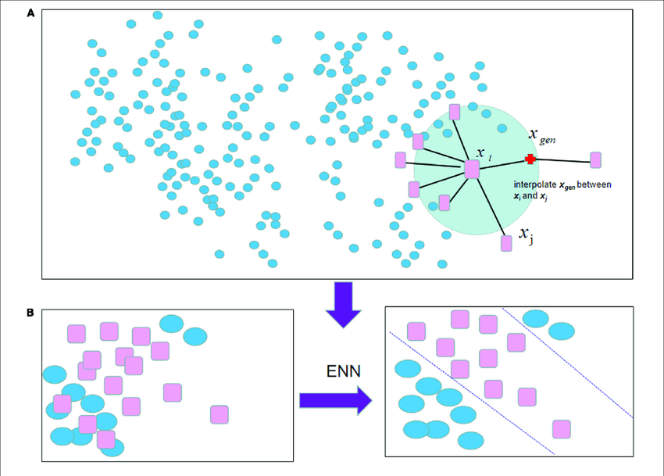
Under/Oversampled Data - Machine Learning
PREV
NEXT
SMOTE
A machine learning technique that solves imbalance data set in classification problems
ENN
This is an undersampling method technique that remove the majority class to match the minority class.
Notes:
https://machinelearningmastery.com/smote-oversampling-for-imbalanced-classification/
https://towardsdatascience.com/smote-fdce2f605729
https://towardsdatascience.com/imbalanced-classification-in-python-smote-enn-method-db5db06b8d50

Slide 31
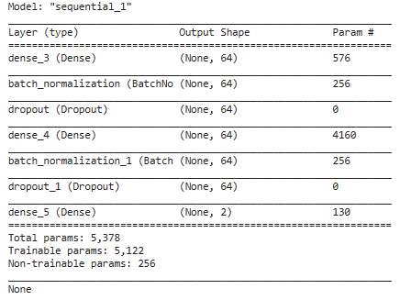
Under/Oversampled Data - Machine Learning
PREV
NEXT
Batch normalization
Normalization technique that is done between the neural network layers
Dropout
Regularization method that drops out the nodes in a neural network to prevent overfitting
Notes:
https://www.baeldung.com/cs/batch-normalization-cnn#:~:text=Batch%20Norm%20is%20a%20normalization,learning%20rates%2C%20making%20learning%20easier.
https://towardsdatascience.com/batch-norm-explained-visually-how-it-works-and-why-neural-networks-need-it-b18919692739
https://towardsdatascience.com/dropout-in-neural-networks-47a162d621d9
https://machinelearningmastery.com/dropout-for-regularizing-deep-neural-networks/

Slide 32
Insights
5
PREV
NEXT

Slide 33
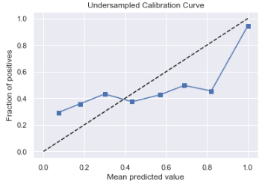
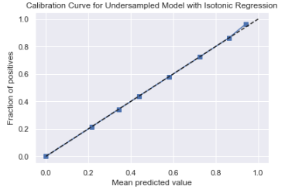
Model - Calibration Curve
PREV
NEXT
Isotonic Regression
An algorithm that finds the non-decreasing approximation of a function which are the closest to the targets.
Before
Isotonic Regression
After
Isotonic Regression
Notes:
Taking the undersampled calibration curve, which is used to compare how well the probabilistic predictions of a binary classifier are calibrated. The more points on the line, the more accurate. We applied Isotonic regression which is an algorithm that finds a non-decreasing approximation of a function which are the closests to the target while minimizing the mean squared error on the training data. And we can see it is more concise now
https://scikit-learn.org/stable/modules/calibration.html#:~:text=Calibration%20curves%20(also%20known%20as,predicted%20probability%20in%20each%20bin.

Slide 34
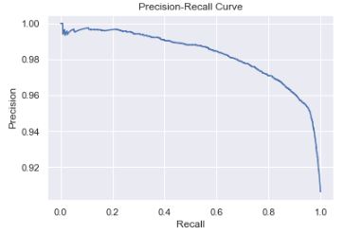
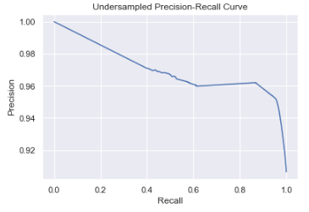
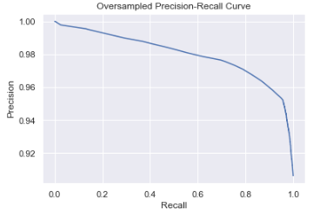
Model - Precision Recall Curve
PREV
NEXT
Original
Under-Sampled
Over-Sampled
Notes:
http://scikit-learn.org/stable/auto_examples/model_selection/plot_precision_recall.html#:~:text=The%20precision%2Drecall%20curve%20shows,a%20low%20false%20negative%20rate.

Slide 35
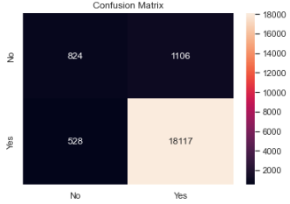
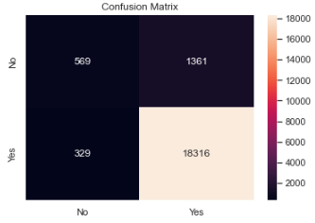
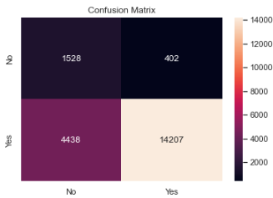
Model -
Accuracy and Confusion Matrix
PREV
NEXT
Original
Under-Sampled
Over-Sampled
Accuracy
FNR
AUC
GINI
92%
0.026
0.88
0.75
91.7%
0.022
0.80
0.60
76.4%
0.262
0.86
0.72
Notes:
https://towardsdatascience.com/understanding-confusion-matrix-a9ad42dcfd62

Slide 36
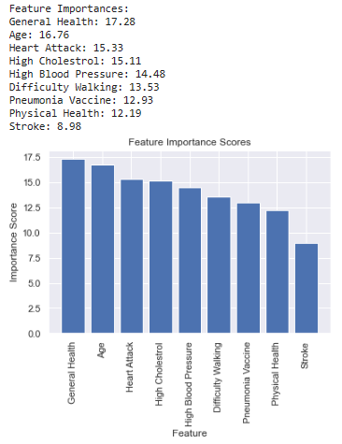
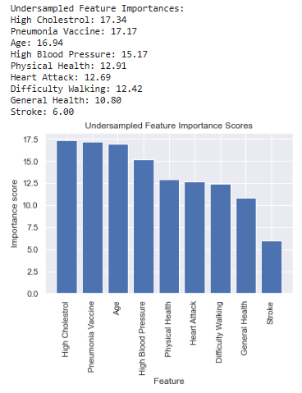
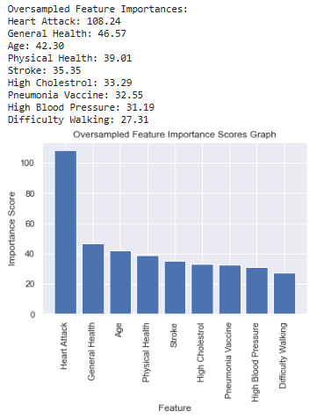
Model - Feature of Importance
PREV
NEXT
Original
Under-Sampled
Over-Sampled
Notes:
https://towardsdatascience.com/understanding-feature-importance-and-how-to-implement-it-in-python-ff0287b20285

Slide 37
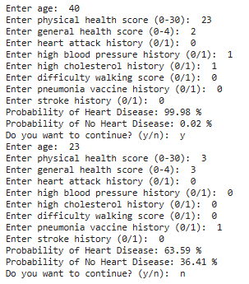
Result
PREV
NEXT

Slide 38
Conclusions
The original model had the highest accuracy of 92.0%
Undersampling has the most balanced dataset
Age is one of the more important variables
All factors still have a relative importance in determining heart disease that cannot be ignored

Slide 39
Thank you!

Slide 40
References
Fig. 1: Differences between undersampling and oversampling. (n.d.). ResearchGate. https://www.researchgate.net/figure/Differences-between-undersampling-and-oversampling_fig1_341164819
Heart Disease and Stroke Prevention. (n.d.). https://www.health.ny.gov/diseases/cardiovascular/heart_disease/#:~:text=About%20697%2C000%20people%20die%20of,Americans%20have%20a%20heart%20attack.
Precision-Recall. (n.d.). Scikit-learn. https://scikit-learn.org/stable/auto_examples/model_selection/plot_precision_recall.html#:~:text=The%20precision%2Drecall%20curve%20shows,a%20low%20false%20negative%20rate.
Shin, T. (2022, November 10). Understanding Feature Importance and How to Implement it in Python. Medium. https://towardsdatascience.com/understanding-feature-importance-and-how-to-implement-it-in-python-ff0287b20285
Narkhede, S. (2021, June 15). Understanding Confusion Matrix - Towards Data Science. Medium. https://towardsdatascience.com/understanding-confusion-matrix-a9ad42dcfd62
Precision-Recall. (n.d.-b). Scikit-learn. http://scikit-learn.org/stable/auto_examples/model_selection/plot_precision_recall.html#:~:text=The%20precision%2Drecall%20curve%20shows,a%20low%20false%20negative%20rate.

Slide 41
References
1.16. Probability calibration. (n.d.). Scikit-learn. https://scikit-learn.org/stable/modules/calibration.html#:~:text=Calibration%20curves%20(also%20known%20as,predicted%20probability%20in%20each%20bin.
Binary Classification. (n.d.). https://www.learndatasci.com/glossary/binary-classification/#:~:text=each%20binary%20classifier-,What%20is%20Binary%20Classification%3F,Application
Binary Cross Entropy: Where To Use Log Loss In Model Monitoring. (2023, March 2). Arize AI. https://arize.com/blog-course/binary-cross-entropy-log-loss/#:~:text=What%20Is%20Binary%20Cross%20Entropy,equate%20to%20high%20accuracy%20values.
Vishwakarma, S. (2023). Why is Sigmoid Function Important in Artificial Neural Networks? Analytics Vidhya. https://www.analyticsvidhya.com/blog/2023/01/why-is-sigmoid-function-important-in-artificial-neural-networks/#:~:text=Source%3A%20Pexels-,The%20sigmoid%20function%20is%20commonly%20used%20as%20an%20activation%20function,non%2Dlinearity%20into%20the%20model.
D’Agostino, A. (2023, February 4). Get started with TensorFlow 2.0 — Introduction to deep learning. Medium. https://towardsdatascience.com/a-comprehensive-introduction-to-tensorflows-sequential-api-and-model-for-deep-learning-c5e31aee49fa#:~:text=The%20sequential%20model%20allows%20us,for%20building%20deep%20learning%20models

Slide 42
References
Brownlee, J. (2019b). A Gentle Introduction to Dropout for Regularizing Deep Neural Networks. MachineLearningMastery.com. https://machinelearningmastery.com/dropout-for-regularizing-deep-neural-networks/
Doshi, K. (2022b, January 6). Batch Norm Explained Visually — How it works, and why neural networks need it. Medium. https://towardsdatascience.com/batch-norm-explained-visually-how-it-works-and-why-neural-networks-need-it-b18919692739
Riva, M., & Riva, M. (2023b). Batch Normalization in Convolutional Neural Networks | Baeldung on Computer Science. Baeldung on Computer Science. https://www.baeldung.com/cs/batch-normalization-cnn#:~:text=Batch%20Norm%20is%20a%20normalization,learning%20rates%2C%20making%20learning%20easier
Yadav, H. (2022, July 7). Dropout in Neural Networks - Towards Data Science. Medium. https://towardsdatascience.com/dropout-in-neural-networks-47a162d621d9
.

